Slide 1
TRAVEL APP – UI/UX
K.A. PREETHI
(211701038)

Slide 2
TABLE OF CONTENTS
INTRODUCTION
OBJECTIVE
PROPOSED TECHNOLOGY
INDUSTRY AND RESEARCH PERSPECTIVE
FUTURE SCOPE
OUTPUT
SUMMARY

Slide 3
INTRODUCTION
In today’s interconnected world, travelers face numerous challenges when planning and executing trips, especially when visiting unfamiliar destinations. The goal is to create a visually appealing user friendly design for an application that integrates Travel Planning, Location details, Language Assistance and Guided tours.
This project embarks on a transformative journey of refining the UI/UX of an integrated travel application. By embracing iterative design methodologies and placing a premium on user feedback and testing, we aspire to redefine the very essence of travel.

Slide 4
OBJECTIVE
Enable users to efficiently plan their trips by providing intuitive tools for activity scheduling, and destination exploration.
Provide users with reliable language support through translation tools, interpretation services, and language learning resources to overcome communication barriers while traveling.
Maintain consistency in branding elements, color schemes, typography, and iconography across the application to reinforce brand recognition and enhance user familiarity.
Ensure that the application's design is responsive and accessible across various devices and screen sizes, adhering to accessibility standards to accommodate users with diverse needs and preferences

Slide 5
PROPOSED TECHNOLOGY
A comprehensive travel application with a language assistance feature, travel planning and guided tours would be a game changer for travelers. The language assistance feature can support voice recognition, text translation.
The application offers immersive guided tours, allowing users to explore popular destinations virtually.
By combining these features into a single platform, the travel application becomes a comprehensive companion for travelers, simplifying every aspect of their journey from planning to exploration.

Slide 6
INDUSTRY AND RESEARCH PERSPECTIVE
SEAMLESS INTEGRATION : The travel ecosystem is complex, involving multiple service providers from airlines, hotels to local tour operators.
SAFETY AND CONVENIENCE : Features like real-time updates, language assistance, and offline functionality provide travellers with the tools they need to navigate unfamiliar environments safely and conveniently.
UX RESEARCH : Understanding how travellers interact with the application can provide insights into optimizing user interfaces and improving usability.

Slide 7
FUTURE SCOPE
ADVANCED AI AND ML : Implement ML algorithms to predict travel trends and personalized recommendations based on user behaviour and preferences.
AR AND VR : VR allows users to take virtual tours of destinations, and attractions before making bookings.
BLOCKCHAIN : For secure and efficient transactions, implement blockchain for payments, bookings and identity verification.
GLOBAL EXPANSION : Expand application’s database to include more destinations globally.

Slide 8
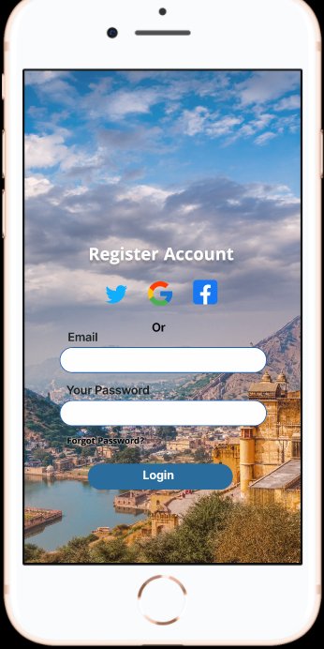
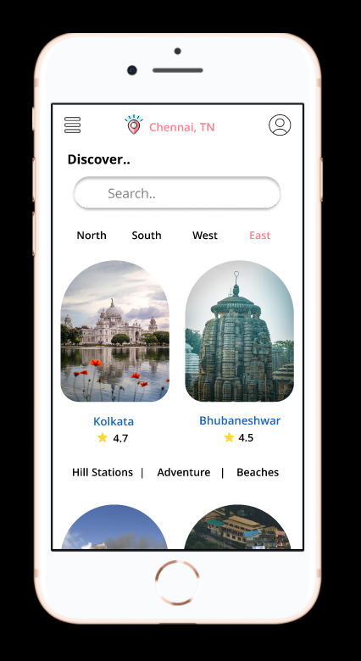
OUTPUT

Slide 9
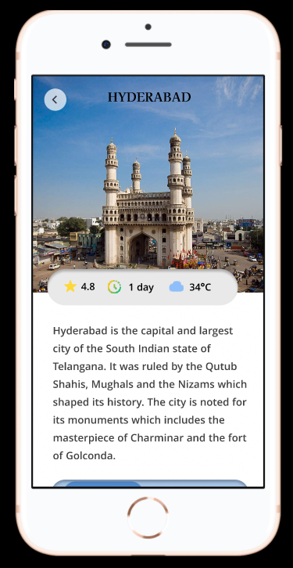
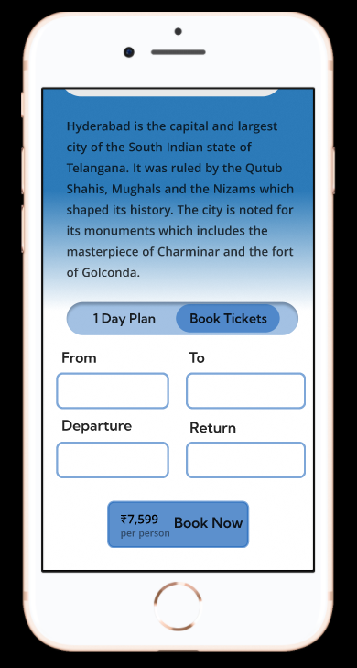
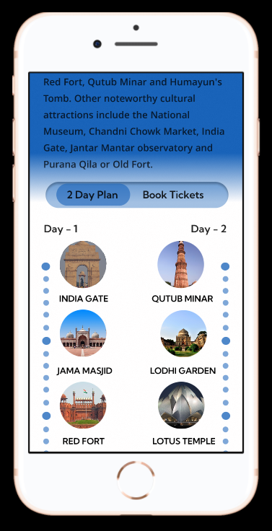

Slide 10
SUMMARY
The goal of designing UI/UX for a travel application is to create an engaging, intuitive, and efficient platform that addresses the diverse needs of travelers. We want users to easily find information about different places they want to visit, such as attractions, places to visit. The app should also help them communicate in different languages and book guided tours if they need help exploring. Overall, our aim is to create an app that makes travel planning fun and stress-free, helping people have amazing experiences wherever they go.

